Slide 1
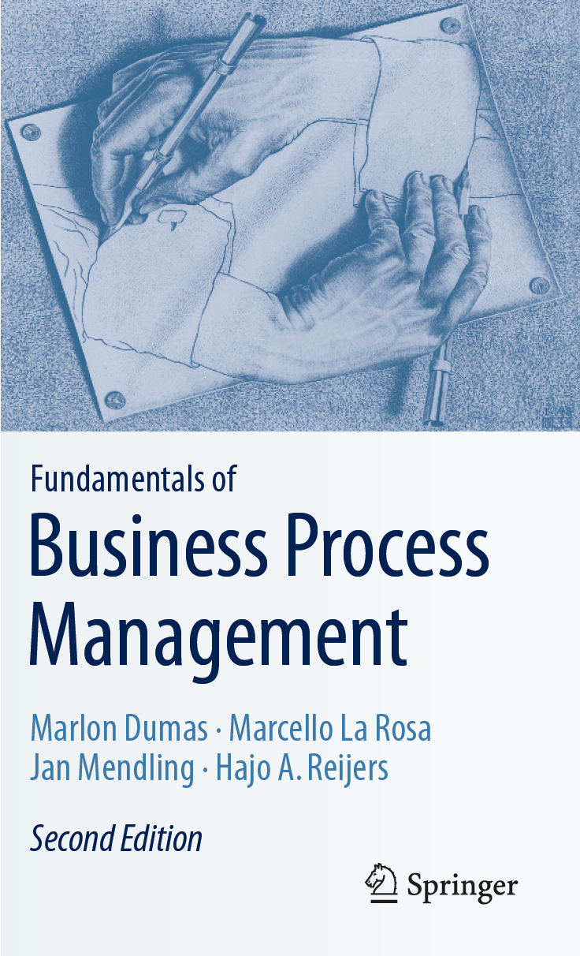
Chapter 11: Process Monitoring
Contents
Performance Dashboards
Introduction to Process Mining
Automated Process Discovery
Process Performance Mining
Conformance Checking
Variants Analysis
Process Mining in Practice
Recap

Slide 2
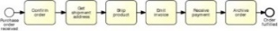
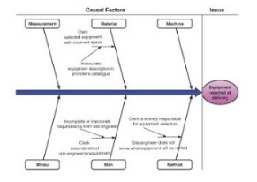
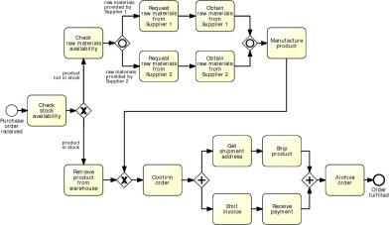
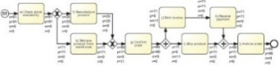
Process Analysis in the BPM Lifecycle

Slide 3
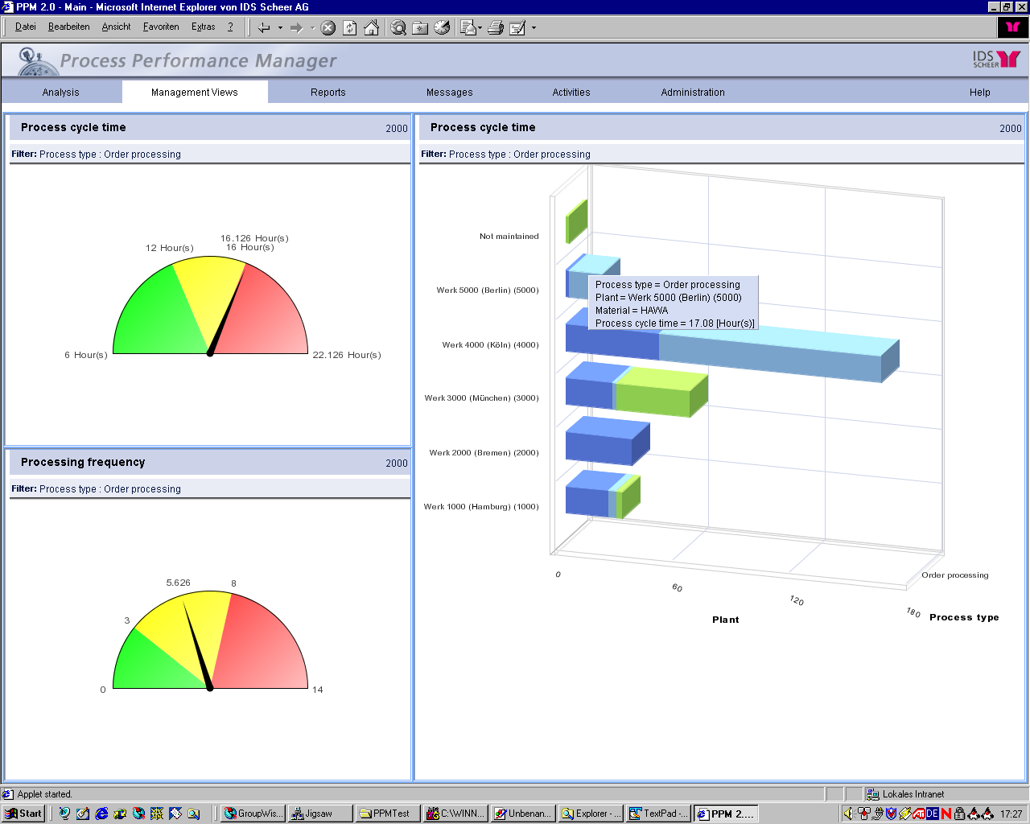

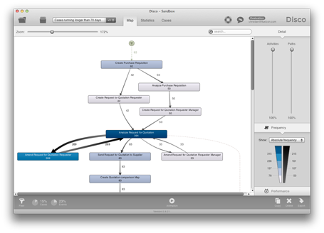
Business Process Monitoring Techniques
Statistics-Based Techniques
Performance Dashboards
Enterprise System
Model-Based Techniques
Process Mining
Database
Event
log
Notes:
This is achieved by analyzing live event streams or historical data from Databases (commonly known as process execution event logs) in order to produce a number of artifacts, which are the results of monitoring and controlling, and can take the form of dashboards, alerts & reports or sophisticated process analytics.
---
Based on these trends, Forrester and Gartner Group are both calling for a new kind of technology management at the process level: e-business process monitoring. The justification for this call is that in e-business environments, automatic interpretation and routing of online information about the status of business process execution will become routine, and messages automatically deriving from inside the company will seamlessly integrate with those from business partners.
Established online brands are already starting to integrate external services. Take the example of Sony Corp., which recently announced a new credit card, mileage program, and online bank. For the online Sony customer, the lines separating the different business divisions of Sony and its partnering bank are no longer visible. Thus, IT service management for such complex services has to guarantee the continuity of business processes regardless of the business unit or service partner performing the action. Only better communication and information integration can achieve this goal.

Slide 4
Chapter 11: Process Monitoring
Contents
Performance Dashboards
Introduction to Process Mining
Automated Process Discovery
Process Performance Mining
Conformance Checing
Variants Analysis
Process Mining in Practice
Recap

Slide 5
Types of process dashboards
Process Dashboards
Operational dashboards (runtime)
Tactical dashboards (historical)
Strategic dashboards (historical)
Notes:
dashboard is a deliverable: purpose used

Slide 6
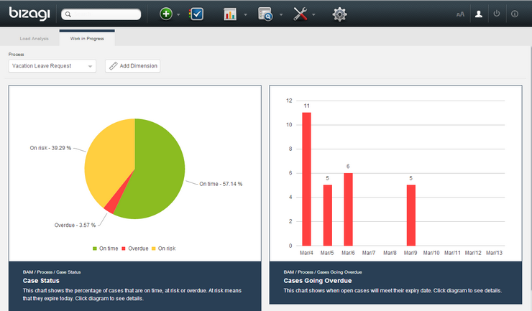
Operational process dashboards
Aimed at process workers & operational managers
Emphasis on monitoring (detect-and-respond), e.g.:
Work-in-progress
Problematic cases – e.g. overdue/at-risk cases
Resource load
Notes:
Bizagi Process Analytics: http://help.bizagi.com/bpmsuite/en/index.html?bam.htm
PER PROCESS (show cases)
Work in progress: A pie-chart shows the percentage of cases that are on time, at risk and overdue. The bar chart on the right shows when open cases will meet their expiry date. The horizontal axis depicts the next ten days and the vertical axis shows the number of cases that will expire in each of them. Cases can be filtered by Process or any of the Dimensions defined.
PER TASK of a process
These are not really predictions, but just based on using standard working time schemas per organization or individual roles (e.g. we work from 9 to 5, 5 days/week)

Slide 7
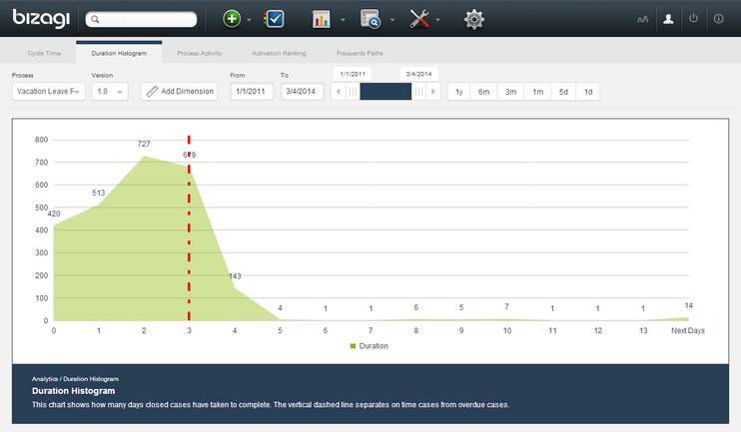
Tactical dashboards
Aimed at process owners / managers
Emphasis on analysis and management
E.g. detecting bottlenecks
Typical process performance indicators
Cycle times
Error rates
Resource utilization
Notes:
http://wiki.bizagi.com/en/index.php?title=Analysis_Reports_Analytics

Slide 8
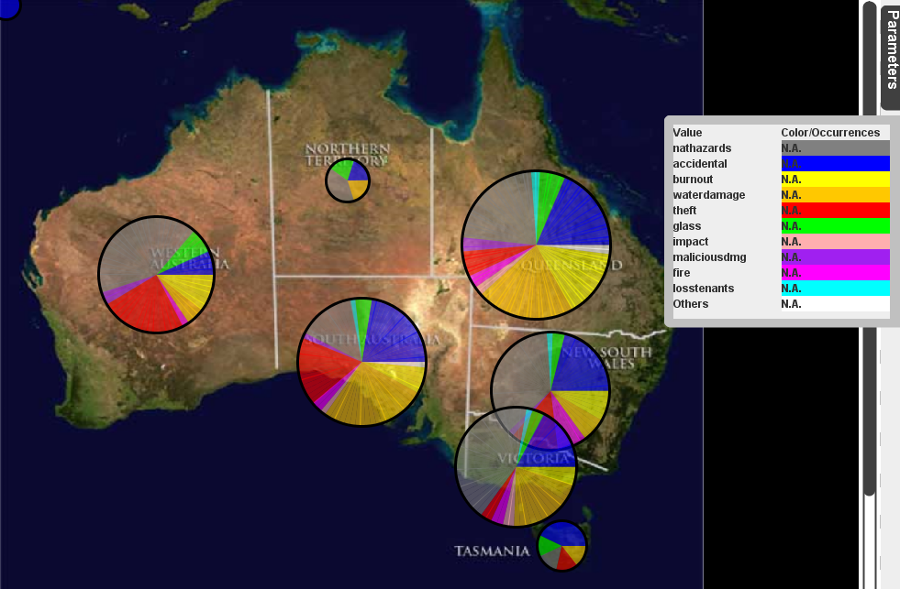
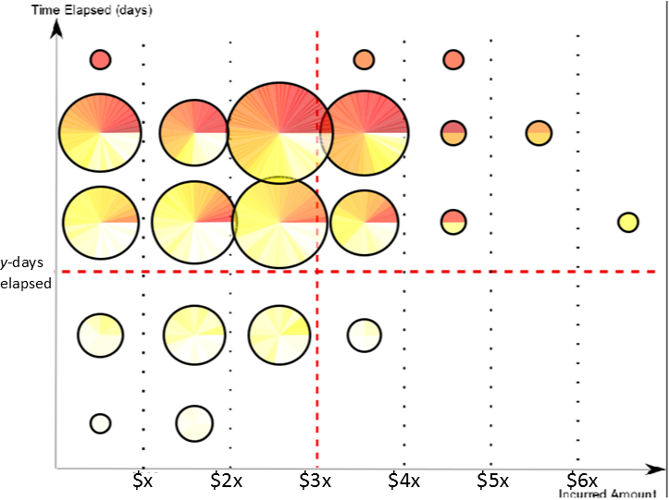
Tactical Performance Dashboard @ Australian Insurer
Notes:
Here is an example of a tactical dashboard used at an Australian insurance company to visualize claims over a 6 month period.
More than half year of log data has been used to create four different movies
Left picture: Each pie represents the different claim types lodged in each state, its size indicates a large or smaller number of claims lodged in that state. The different coloured parts represent the different claim types lodged.
Right Picture: each pie represents Claims lodged. The colour represents the age of the claim (the more ‘dark’ colours the older the claims are in the system). The animation projects claims into their performance on the y-axis (total claim duration) with respect to total claim payout (x-axis). Many claims below 5k took more than 30 days to complete (upper left quadrant)
-Generated animations have been shown to Suncorps employees – We received positive feedback. Mostly, that they saw a factual pictorial showing the findings in a very simple way.
- Animations are played over time so one can see the trend or changes in process performance
-This tool is Prom 6.2 which is an Open source tool, freely to be used by any organizations www.processmining.org (ProM 6.2)

Slide 9
Strategic dashboards
Aimed at executives & managers
Emphasis on linking process performance to strategic objectives

Slide 10
Strategic Performance Dashboard @ Australian Utilities Provider
 | Manage Unplanned Outages | Manage Emergencies & Disasters | Manage Work Programming & Resourcing | Manage Procurement
Customer Satisfaction | 0.5 | 0.55 | - | 0.2
Customer Complaint | 0.6 | - | - | 0.5
Customer Feedback | 0.4 | - | - | 0.8
Connection Less Than Agreed Time | 0.3 | 0.6 | 0.7 | -
Process
Key Performance
Notes:
This is just part of a broader “scorecard” that included other dimensions included in the following slide

Slide 11
Process: Manage Procurement
0.67
Process: Manage Emergencies & Disasters
0.58
Process: Manage Unplanned Outages
Overall Process Performance
0.54
1st Layer
Key Result
Area
Financial
People
Customer
Excellence
Operational
Excellence
Risk
Management
Health
& Safety
0.5
0.4
0.65
0.5
0.8
0.4
2nd Layer
Key Performance
Customer
Complaint
Customer
Satisfaction
0.6
0.7
3rd & 4th Layer
Process Performance
Measures
Customer
Rating (%)
Customer
Loyalty Index
Average Time
Spent on Plan
0.7
0.6
0.8
Satisfied
Customer Index
Market
Share (%)
0.4
0.8

Slide 12
Teamwork
Sketch operational and tactical process monitoring dashboards for CVS Pharmacy’s prescription fulfillment process (See Chapter 1, Exercise 1.6).
Consider the viewpoints of each stakeholder in the process.
Customer
Pharmacist
Technician
Process owner (overseeing 500+ pharmacies distributed geographically)

Slide 13

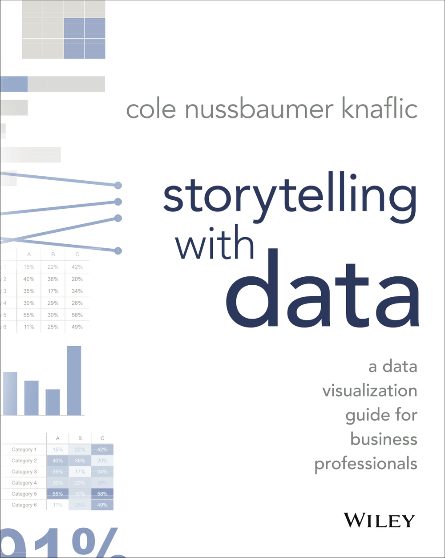

Slide 14
Chapter 11: Process Monitoring
Contents
Performance Dashboards
Introduction to Process Mining
Automated Process Discovery
Process Performance Mining
Conformance Checing
Variants Analysis
Process Mining in Practice
Recap

Slide 15
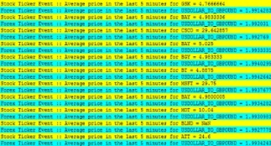
Business Process Monitoring
Dashboards & reports
Event
stream
Process mining
Event
log
DB logs
Notes:
This is achieved by analyzing live event streams or historical data from Databases (commonly known as process execution event logs) in order to produce a number of artifacts, which are the results of monitoring and controlling, and can take the form of dashboards, alerts & reports or sophisticated process analytics.
---
Based on these trends, Forrester and Gartner Group are both calling for a new kind of technology management at the process level: e-business process monitoring. The justification for this call is that in e-business environments, automatic interpretation and routing of online information about the status of business process execution will become routine, and messages automatically deriving from inside the company will seamlessly integrate with those from business partners.
Established online brands are already starting to integrate external services. Take the example of Sony Corp., which recently announced a new credit card, mileage program, and online bank. For the online Sony customer, the lines separating the different business divisions of Sony and its partnering bank are no longer visible. Thus, IT service management for such complex services has to guarantee the continuity of business processes regardless of the business unit or service partner performing the action. Only better communication and information integration can achieve this goal.

Slide 16
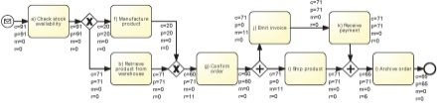
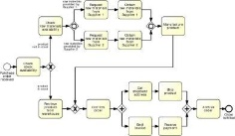
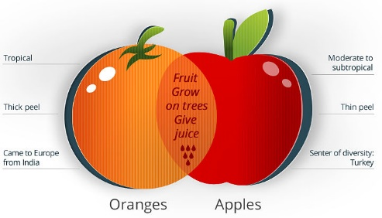
Process Mining
Discovery
discovered model
Performance
Deviance
event log
Enhanced model
Difference
diagnostics
event log’
Conformance
✓/✗
input model

Slide 17
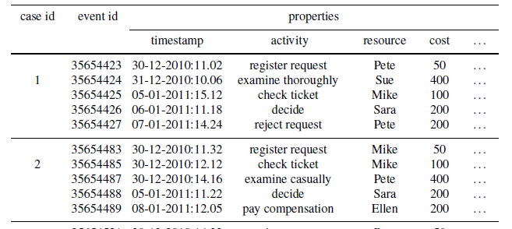

Event logs structure: minimum requirements
Concrete formats:
Comma-Separated Values (CSV)
XES (XML format)

Slide 18
Chapter 11: Process Monitoring
Contents
Performance Dashboards
Introduction to Process Mining
Automated Process Discovery
Process Performance Mining
Conformance Checking
Variants Analysis
Process Mining in Practice
Recap

Slide 19
Automated Process Discovery
CID | Task | Time Stamp | …
13219 | Enter Loan Application | 2007-11-09 T 11:20:10 | -
13219 | Retrieve Applicant Data | 2007-11-09 T 11:22:15 | -
13220 | Enter Loan Application | 2007-11-09 T 11:22:40 | -
13219 | Compute Installments | 2007-11-09 T 11:22:45 | -
13219 | Notify Eligibility | 2007-11-09 T 11:23:00 | -
13219 | Approve Simple Application | 2007-11-09 T 11:24:30 | -
13220 | Compute Installements | 2007-11-09 T 11:24:35 | -
… | … | … | …

Slide 20
Process Mining Tools
Open-source
Apromore
ProM
Lightweight
Disco
Mid-range
Minit
myInvenio
QPR Process Analyzer
Signavio Process Intelligence
StereoLOGIC Discovery Analyst
Heavyweight
ARIS Process Performance Manager
Celonis Process Mining
Perceptive Process Mining (Lexmark)
Interstage Process Discovery (Fujitsu)
Lana Labs

Slide 21
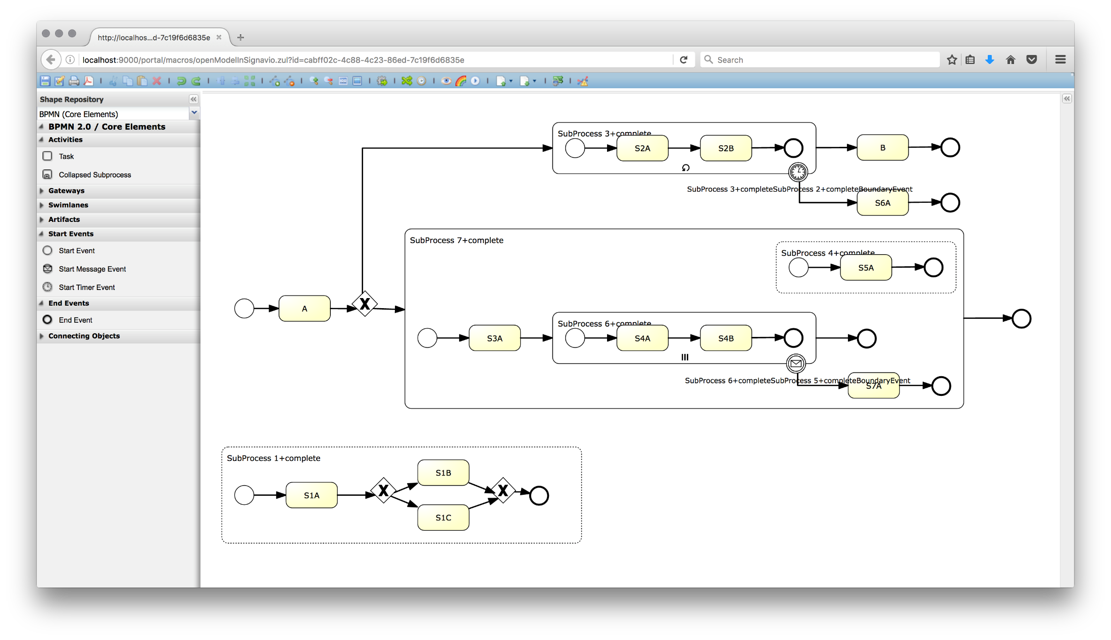
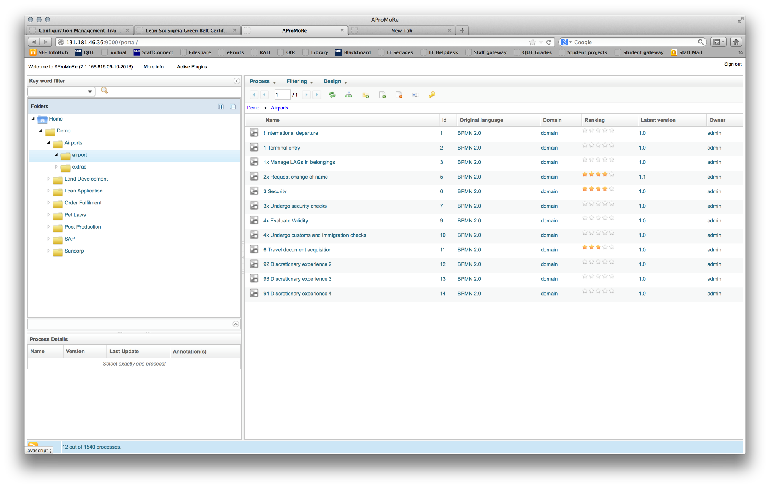
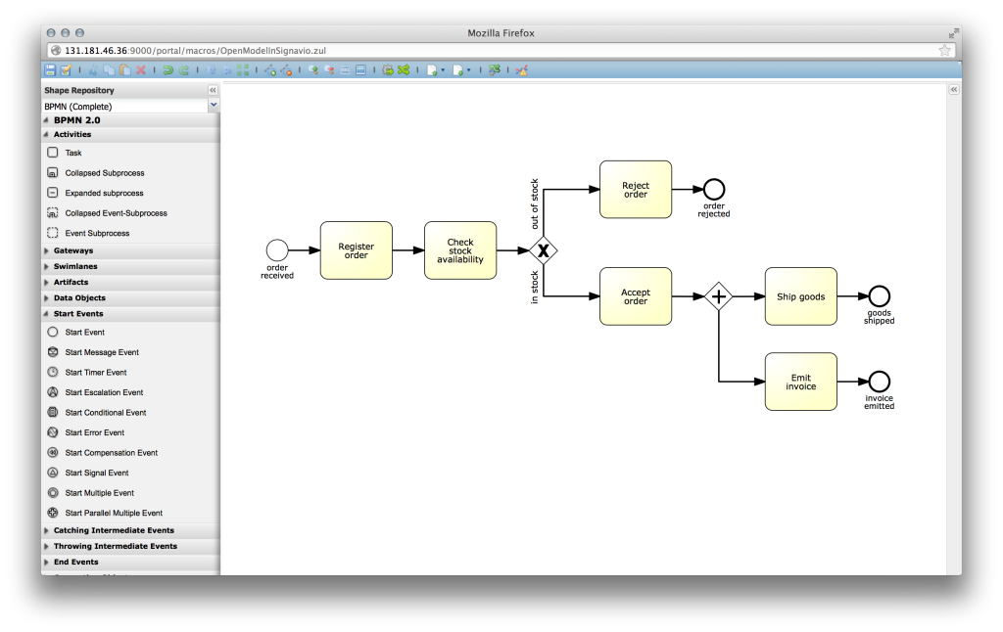
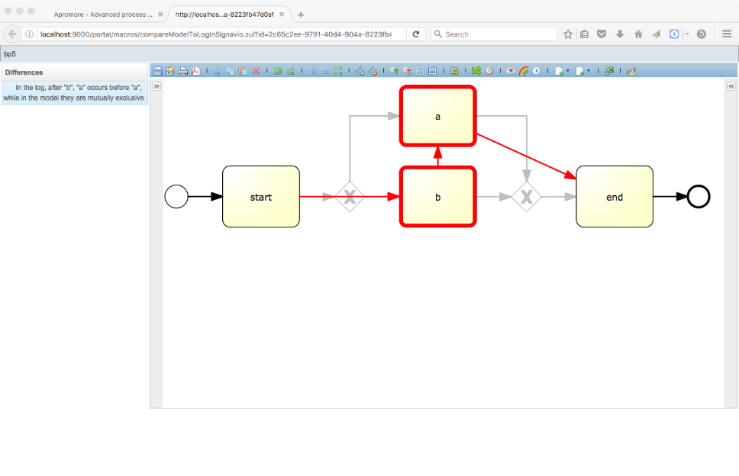

Apromore.org

Slide 22
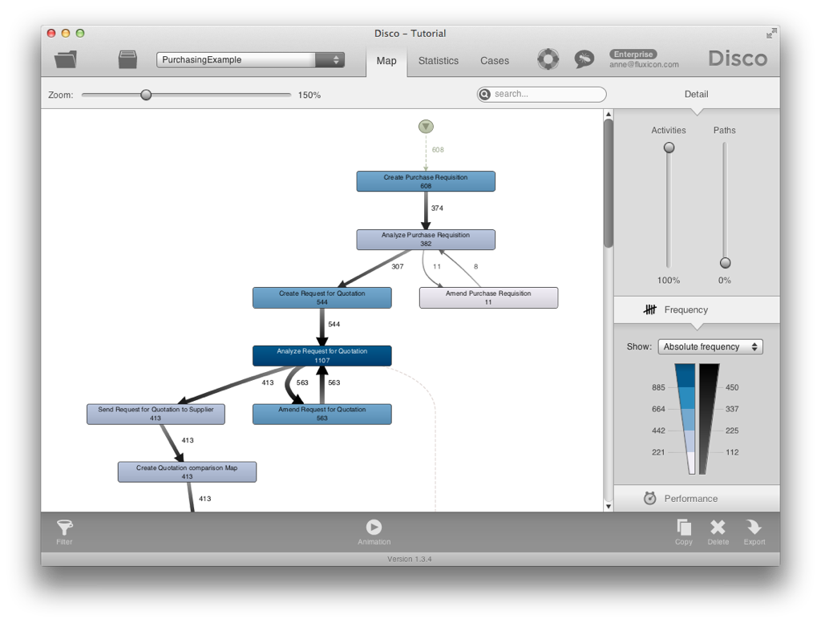
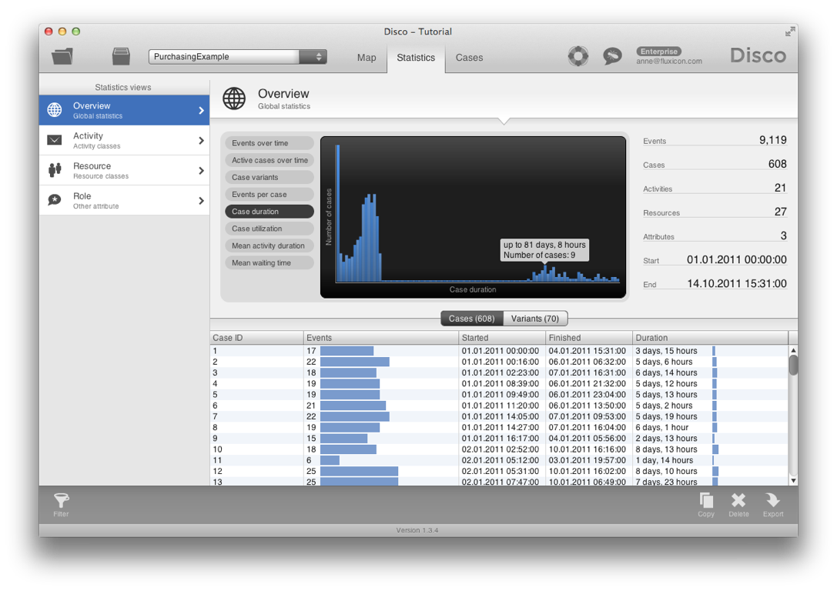
Fluxicon Disco

Slide 23
Process Maps (a.k.a. Directly-Follows Graphs)
A process map of an event log is a graph where:
Each activity is represented by one node
An arc from activity A to activity B means that B is directly followed by A in at least one trace in the log
Arcs in a process map can be annotated with:
Absolute frequency: how many times B directly follows A?
Relative frequency: in what percentage of times when A is executed, it is directly followed by B?
Time: What is the average time between the occurrence of A and the occurrence of B? (cf. performance mining)

Slide 24
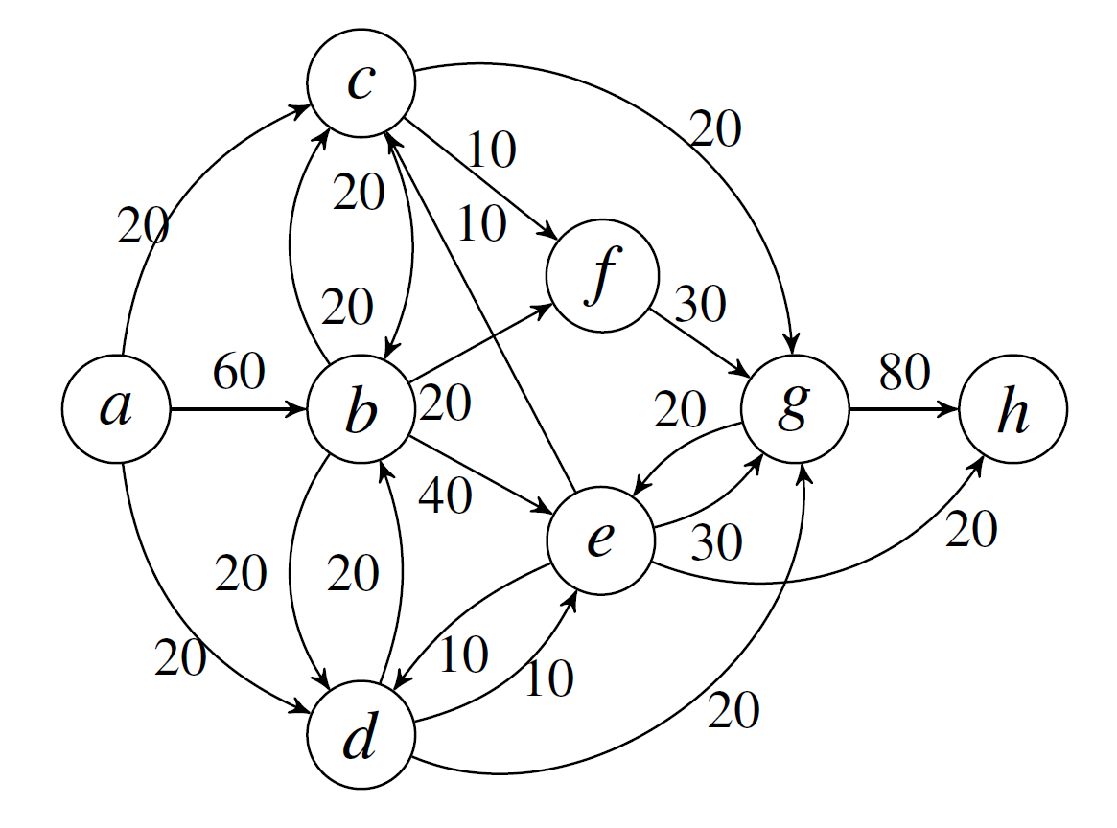
Process Maps – Example
Event log:
10: a,b,c,g,e,h
10: a,b,c,f,g,h
10: a,b,d,g,e,h
10: a,b,d,e,g,h
10: a,b,e,c,g,h
10: a,b,e,d,g,h
10: a,c,b,e,g,h
10: a,c,b,f,g,h
10: a,d,b,e,g,h
10: a,d,b,f,g,h

Slide 25
Process Maps – Exercise
Case ID | Task Name | Originator | Timestamp | Case ID | Task Name | Originator | Timestamp
1 | File Fine | Anne | 20-07-2004 14:00:00 | 3 | Reminder | John | 21-08-2004 10:00:00
2 | File Fine | Anne | 20-07-2004 15:00:00 | 2 | Process Payment | system | 22-08-2004 09:05:00
1 | Send Bill | system | 20-07-2004 15:05:00 | 2 | Close case | system | 22-08-2004 09:06:00
2 | Send Bill | system | 20-07-2004 15:07:00 | 4 | Reminder | John | 22-08-2004 15:10:00
3 | File Fine | Anne | 21-07-2004 10:00:00 | 4 | Reminder | Mary | 22-08-2004 17:10:00
3 | Send Bill | system | 21-07-2004 14:00:00 | 4 | Process Payment | system | 29-08-2004 14:01:00
4 | File Fine | Anne | 22-07-2004 11:00:00 | 4 | Close Case | system | 29-08-2004 17:30:00
4 | Send Bill | system | 22-07-2004 11:10:00 | 3 | Reminder | John | 21-09-2004 10:00:00
1 | Process Payment | system | 24-07-2004 15:05:00 | 3 | Reminder | John | 21-10-2004 10:00:00
1 | Close Case | system | 24-07-2004 15:06:00 | 3 | Process Payment | system | 25-10-2004 14:00:00
2 | Reminder | Mary | 20-08-2004 10:00:00 | 3 | Close Case | system | 25-10-2004 14:01:00

Slide 26
Process Maps in Disco
Disco (and other commercial process mining tools) use process maps to visualize event logs
It also provides operations to filter the process map:
By activities
By paths

Slide 27
Abstraction and Filtering
To cope with the complexity of large real-life logs, process maps are often used in conjunction with two operations:
Abstract the process map:
Show only most frequent activities
Show only most frequent arcs
Filter the traces in the event log
Remove traces that fulfil a condition (or traces that do not fulfil a condition)

Slide 28
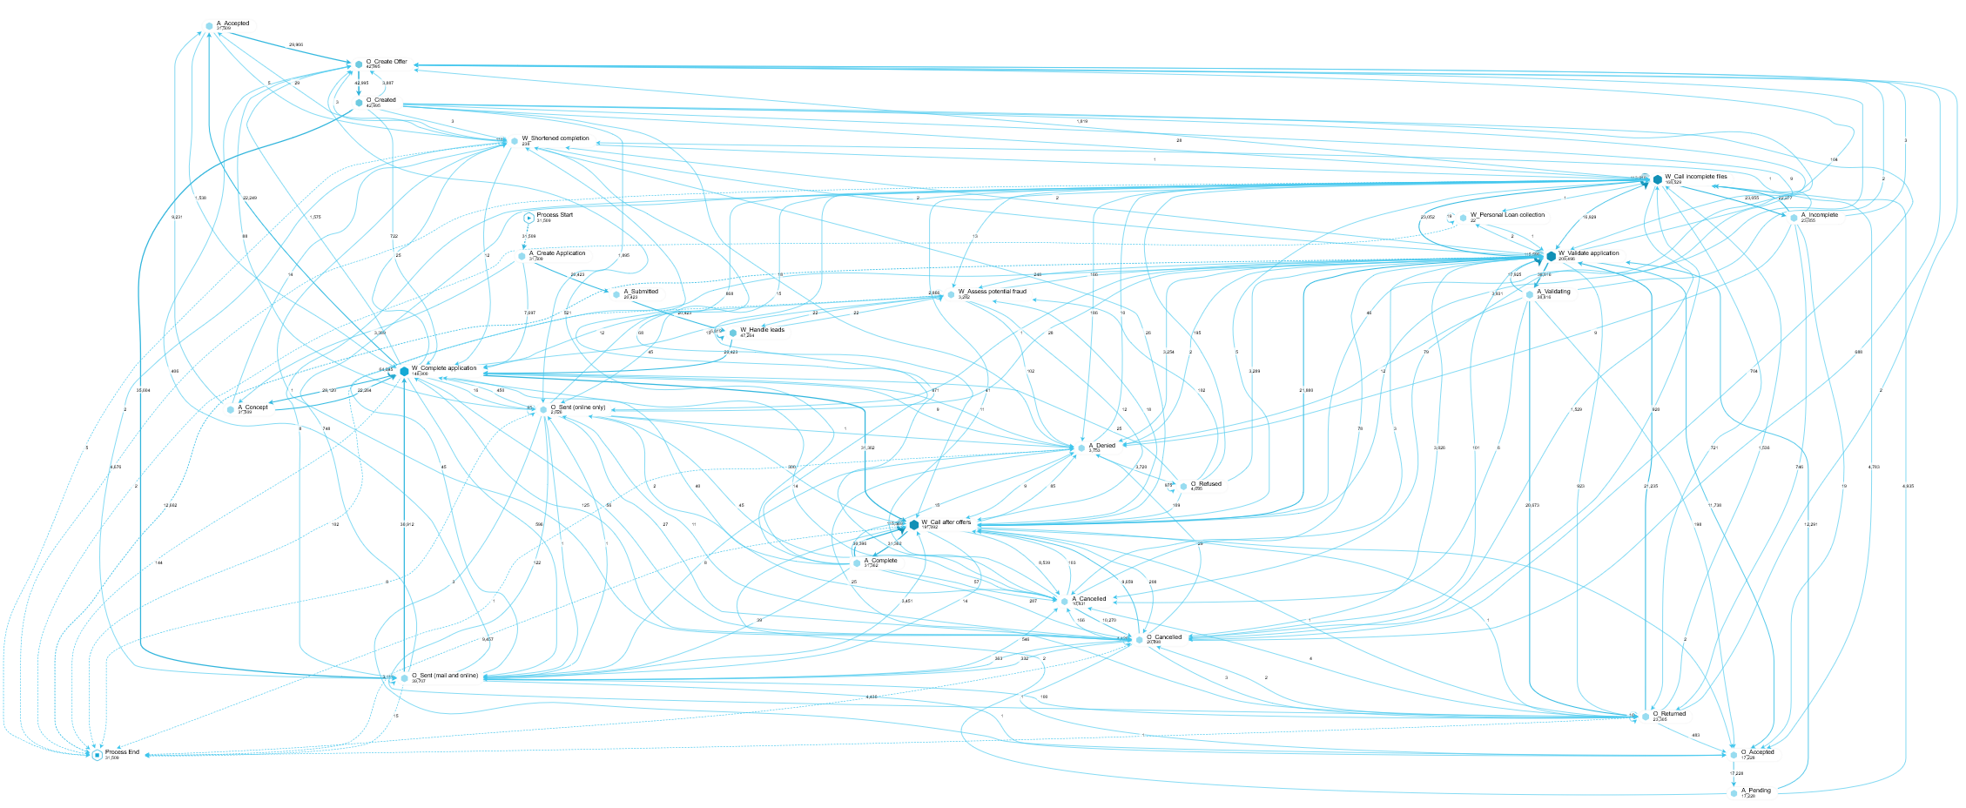
Raw process maps of a real-life log (In Celonis)

Slide 29
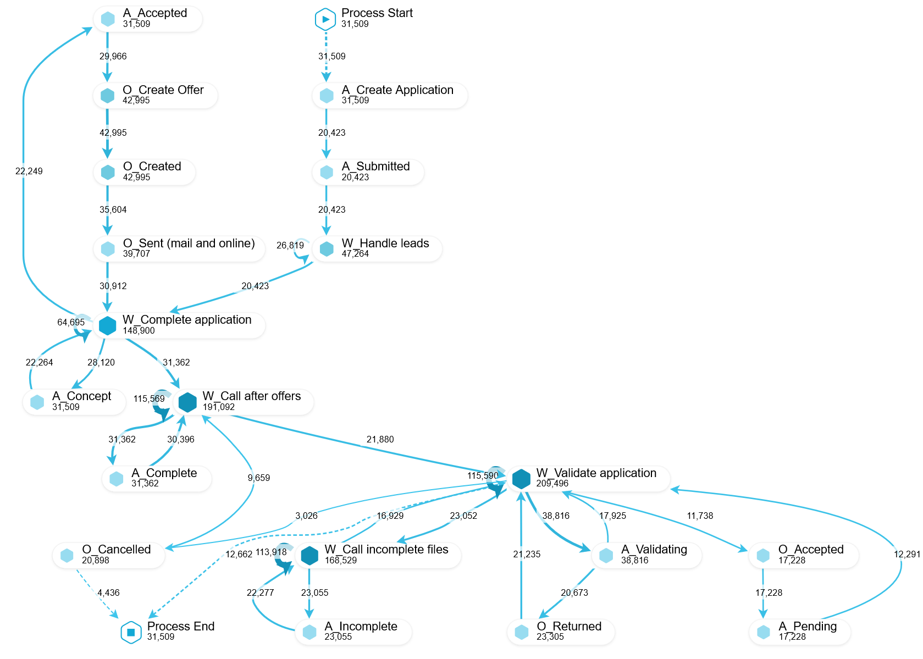
Abstracted map (In Celonis)
90% of node abstraction, 98% arc abstraction

Slide 30
Filtering
Four types of common filters on event logs:
Event filters
Retain only events that fulfil a given condition (e.g. all events of type “Create purchase order”)
Or retain only traces that contain a given event (e.g. only traces that contain evemt “Cancel purchase order”)
Performance filter
Retain traces that have a duration above or below a given value
Event pair filter (a.k.a. “follower” filter)
Retain traces where there is a pair of events that fulfil a given condition (e.g. “Create invoice” followed by “Create purchase order”)
Endpoint filter
Retain traces that start with or finish with an event that fulfils a given condition

Slide 31
Exercise
Using Disco or another tool supporting process maps, answer the following questions on the PurchasingExample log:
How many cases had to settle a dispute with the purchasing agent?
Is there a difference in cycle time for the cases that had to settle a dispute with the purchasing agent, compared to the ones that did not? Make sure you only compare cases that actually reach the endpoint ‘Pay invoice’
Are there any cases where the invoice is released and authorized by the same resource? And if so, who is doing this most often?
Exercise by Anne Rozinat

Slide 32
Discovering (BPMN) Process Models
Alpha miner (α-miner)
Simple, limited, not robust
Heuristics miner
Robust to noise, fast, often a good tradeoff but can produce incorrect models
Inductive miner (ProM v6)
Ensures that models are block-structured & correct
Structured miner (Apromore)
Improves heuristics miner to produce maximally block-structured process models

Slide 33
α-miner Basic Idea: Ordering relations
Direct succession: x>y iff for some case x is directly followed by y.
Causality: x→y iff x>y and not y>x.
Parallel: x||y iff x>y and y>x
Unrelated: x#y iff not x>y and not y>x.
case 1 : task A
case 2 : task A
case 3 : task A
case 3 : task B
case 1 : task B
case 1 : task C
case 2 : task C
case 4 : task A
case 2 : task B
...
ABCD
ACBD
EF
A>B
A>C
B>C
B>D
C>B
C>D
E>F
A→B
A→C
B→D
C→D
E→F
B||C
C||B

Slide 34
Basic Idea: Example

Slide 35
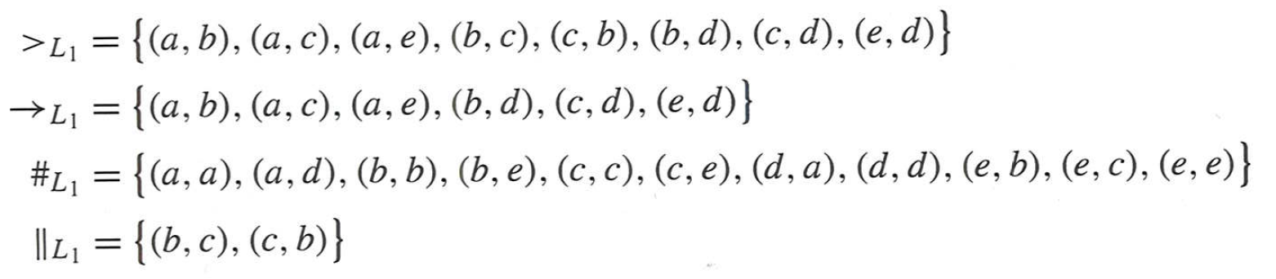
Basic Idea: Example

Slide 36
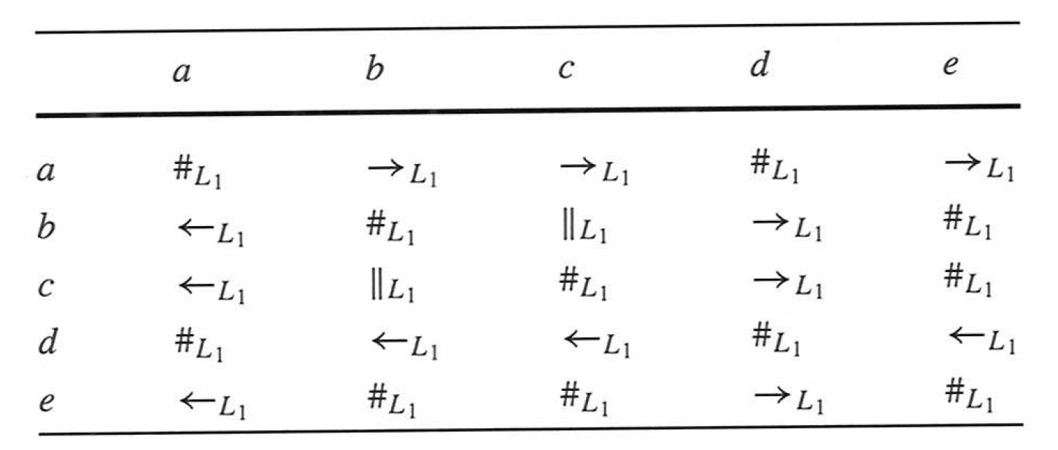
Basic Idea: Footprints

Slide 37

α-Algorithm
Idea (a)
⇔
a → b

Slide 38
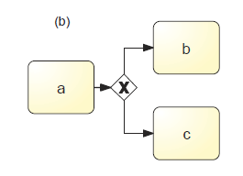
α-Algorithm
Idea (b)
⇔
a→ b, a→ c and b # c

Slide 39
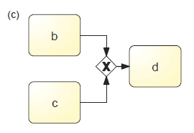
α-Algorithm
Idea (c)
⇔
b→ d, c→ d and b # c

Slide 40
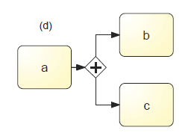
α-Algorithm
Idea (d)
⇔
a→ b, a→ c and b || c

Slide 41
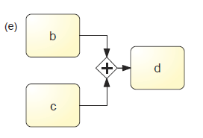
α-Algorithm
Idea (e)
⇔
b→ d, c→ d and b || c

Slide 42
Process Model Discovery – Exercise
Case ID | Task Name | Originator | Timestamp | Case ID | Task Name | Originator | Timestamp
1 | File Fine | Anne | 20-07-2004 14:00:00 | 3 | Reminder | John | 21-08-2004 10:00:00
2 | File Fine | Anne | 20-07-2004 15:00:00 | 2 | Process Payment | system | 22-08-2004 09:05:00
1 | Send Bill | system | 20-07-2004 15:05:00 | 2 | Close case | system | 22-08-2004 09:06:00
2 | Send Bill | system | 20-07-2004 15:07:00 | 4 | Reminder | John | 22-08-2004 15:10:00
3 | File Fine | Anne | 21-07-2004 10:00:00 | 4 | Reminder | Mary | 22-08-2004 17:10:00
3 | Send Bill | system | 21-07-2004 14:00:00 | 4 | Process Payment | system | 29-08-2004 14:01:00
4 | File Fine | Anne | 22-07-2004 11:00:00 | 4 | Close Case | system | 29-08-2004 17:30:00
4 | Send Bill | system | 22-07-2004 11:10:00 | 3 | Reminder | John | 21-09-2004 10:00:00
1 | Process Payment | system | 24-07-2004 15:05:00 | 3 | Reminder | John | 21-10-2004 10:00:00
1 | Close Case | system | 24-07-2004 15:06:00 | 3 | Process Payment | system | 25-10-2004 14:00:00
2 | Reminder | Mary | 20-08-2004 10:00:00 | 3 | Close Case | system | 25-10-2004 14:01:00

Slide 43

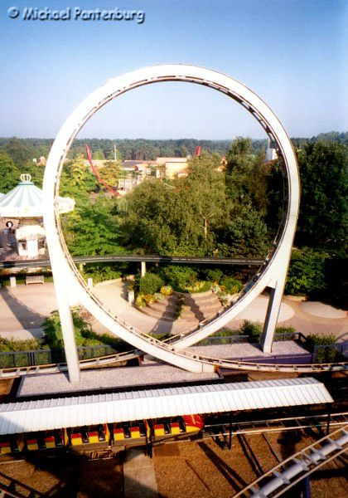
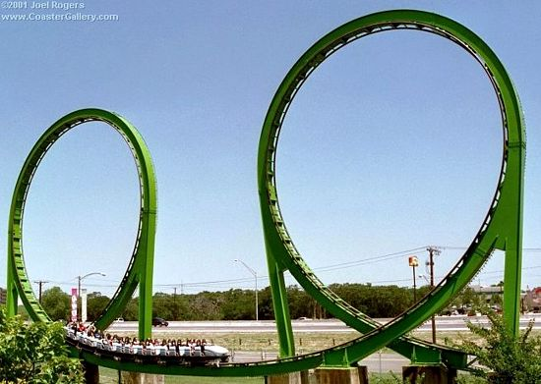
Limitations of alpha miner
Completeness
All possible traces of the process (model) need to be in the log
Self-loops
b>b and not b>b implies b→b (impossible!)
Short loops
c>b and b>c implies c||b and b||c instead of c→b and b→c

Slide 44
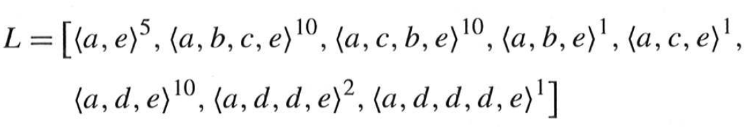
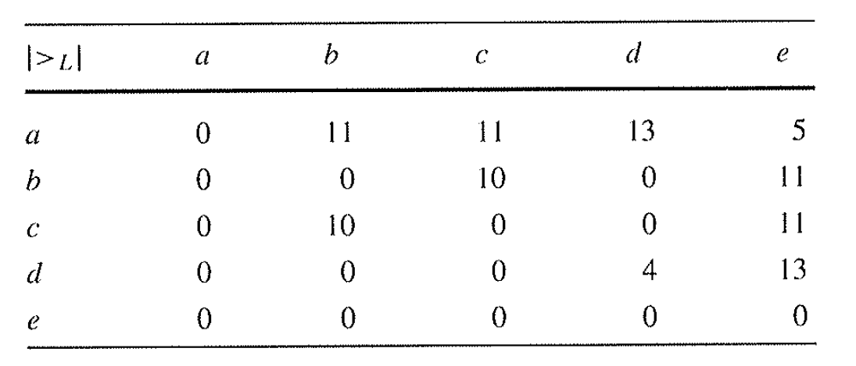
Heuristic Miner
Process Map

Slide 45
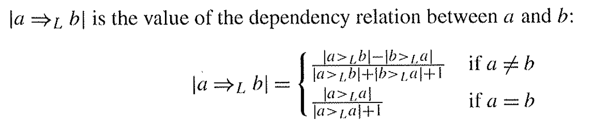
Heuristic Miner

Slide 46
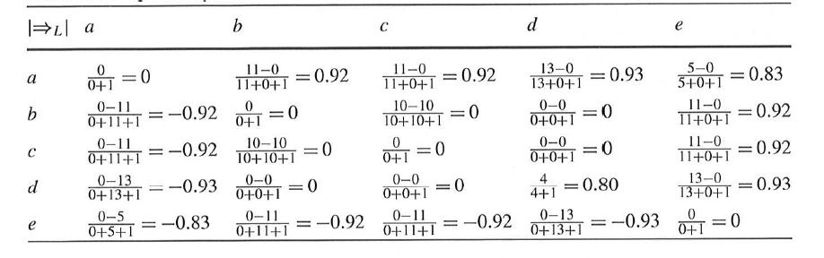
Heuristic Miner

Slide 47
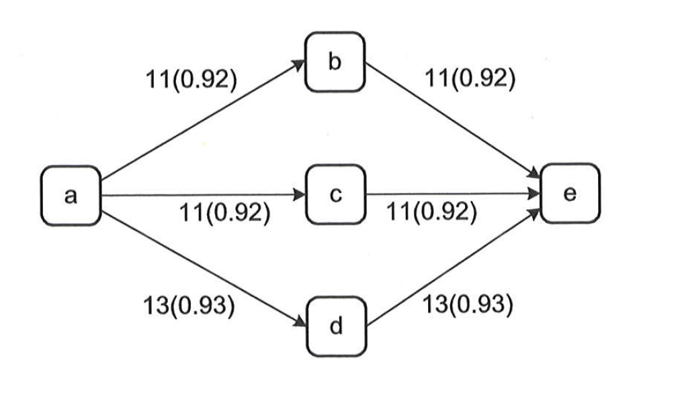
Heuristic Miner
What’s the corresponding process model?

Slide 48
Automated Process Discovery
Automated process discovery method
Simplicity
minimal size & structural complexity
Precision
does not parse traces not in the log
Fitness
parses the traces of the log
Generalization
parses traces of the process not included in the log

Slide 49
Accuracy of Automated Process Discovery
Lack of generalization
Process
Model
Log
Lack of precision
Lack of fitness

Slide 50
Process Discovery Algorithms: The Two Worlds
High-Fitness
High-Precision
Heuristic Miner
Fodina Miner
High-Fitness
Low-Complexity

Slide 51
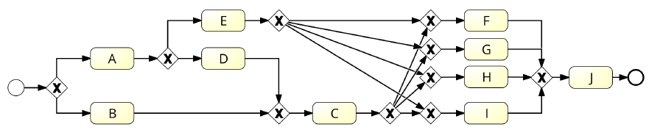
Process Model discovered with Heuristics Miner

Slide 52
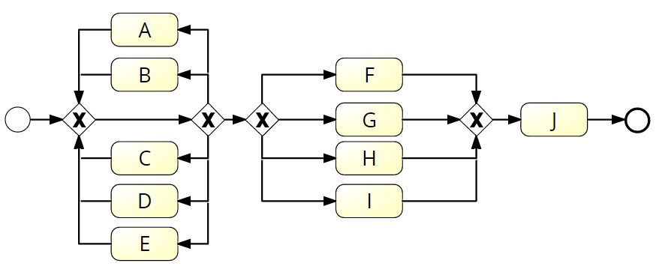
Process Model discovered with Inductive Miner
Structured by construction
Based on process tree

Slide 53
Process Discovery Algorithms: The Two Worlds
High-Fitness
High-Precision
Heuristic Miner
Fodina Miner
High-Fitness
Low-Complexity
Inductive Miner
Evolutionary Tree Miner

Slide 54
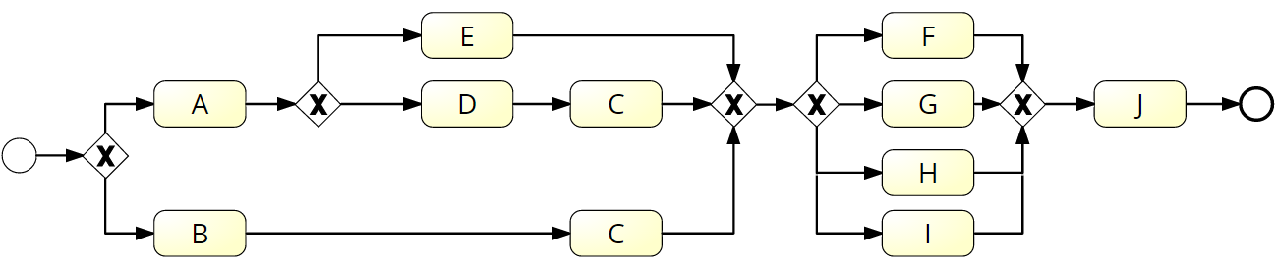
Process Model discovered with Structured Miner

Slide 55
Process Discovery Algorithms
High-Fitness
High-Precision
Low-Complexity
Structured Miner

Slide 56
Automated Process Discovery Structured Miner + Subprocess Identification
Apromore.org

Slide 57
Chapter 11: Process Monitoring
Contents
Performance Dashboards
Introduction to Process Mining
Automated Process Discovery
Process Performance Mining
Conformance Checking
Variants Analysis
Process Mining in Practice
Recap

Slide 58
Visual Process Performance Mining Techniques
Dotted charts
One line per trace, each line contains points, one point per event
Each event type is mapped to a colour
Position of the point denotes its occurrence time (in a relative scale)
Birds-eye view of the timing of different events (e.g. activity end times), but does not allow one to see the “processing” times of activities
Timeline diagrams
One line per trace, each line contains segments capturing the start and end of tasks
Captures process time (unlike dotted charts)
Not scalable for large event logs – good to show “representative” traces
Performance-enhanced process maps
Process maps where nodes are colour-coded with respect to a performance measure. Typically edge colour denotes waiting time, node colour denotes processing time.
Nodes may represent activities (default option)
But they may represent resources and then arcs denote hands-offs between resources

Slide 59
Dotted chart

Slide 60
Timeline diagram

Slide 61
Performance-enhanced process map Nodes are activities (default)
Screenshot of Disco

Slide 62
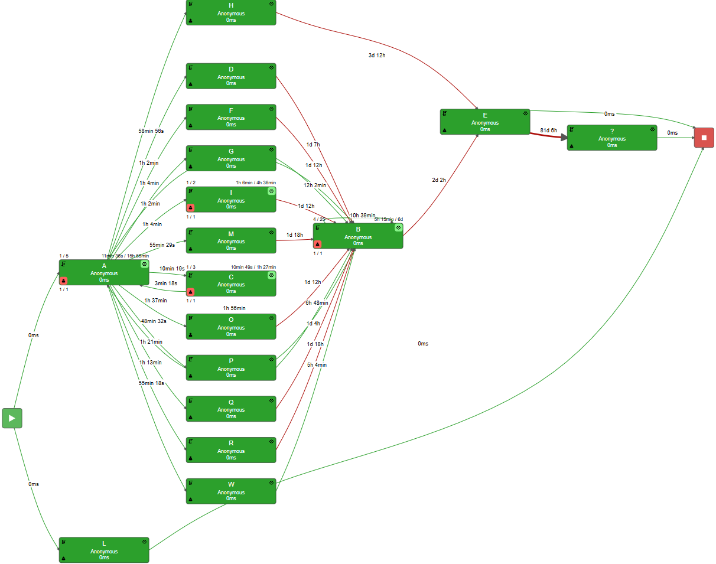
Performance-enhanced process map Nodes are tasks (handoff graph)
Screenshot of MyInvenio

Slide 63
Chapter 11: Process Monitoring
Contents
Performance Dashboards
Introduction to Process Mining
Automated Process Discovery
Process Performance Mining
Conformance Checking
Variants Analysis
Process Mining in Practice
Recap

Slide 64

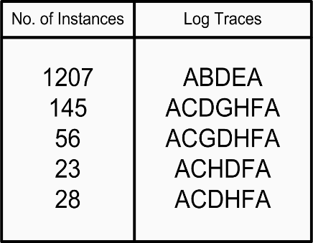
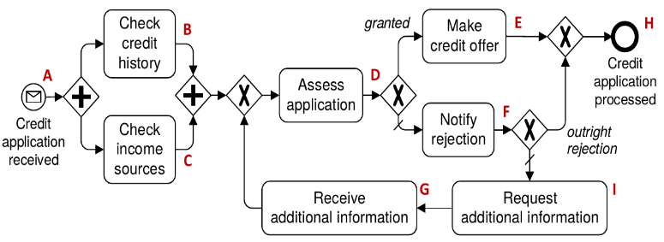
Conformance Checking
≠

Slide 65
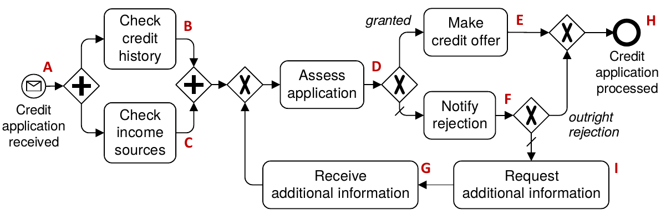
Conformance Checking: Unfitting vs. Additional Behavior
Event log:
ABCDEH
ACBDEH
ABCDFH
ACBDFH
ABDEH
ABDFH
Unfitting behaviour:
Task C is optional (i.e. may be skipped) in the log
Additional behavior:
The cycle including IGDF is not observed in the log
Notes:
The first statement characterizes the behavior observed in the log but not in the model: in the model, task C is compulsory, while in the log C is skippable
The second statement characterizes the behavior observed in the model but not in the log
Trace alignment would produce two optimal alignments:
One between ABDEH of the log and ABCDHE of the model, the other between ABDFH of the log and ABCDFH of the model. From this one can infer that task C is optional in the log (move on log only).
1) However the number of misaligned traces is often very large, rendering this inference quite hard in practice. Visualizations, e.g. on top of Petri net, and at an aggregate level, can help, but fundamentally the problem is that trace alignment provides feedback at the level of individual traces, not at the level of behavioral relations observed in the log but not captured in the model.
2) Moreover, trace alignment would detect that there is escaping behavior starting with “Request addition information” at a trace prefix finishing with “Notify rejection”, but it will not identify that the extra behavior includes tasks IG and that IGDF is behavior that can be repeated in the model but not in the log. For example, task “Assess application” can be repeated in the model but not in the log.

Slide 66
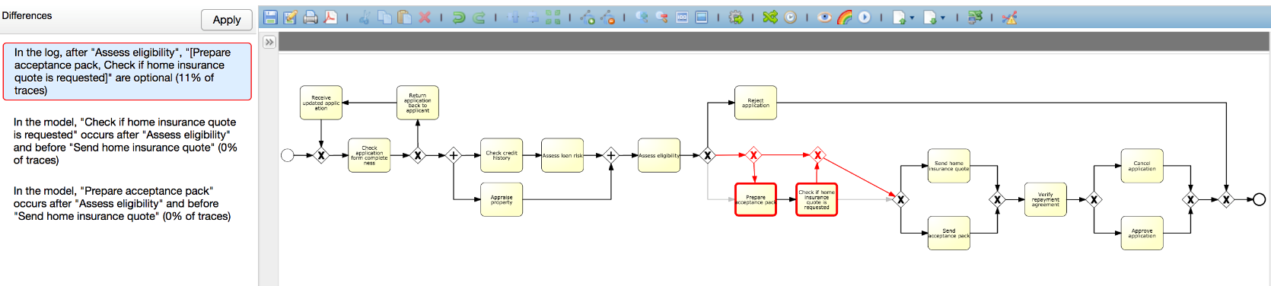
Conformance Checking in Apromore
Full demo at: https://www.youtube.com/watch?v=3d00pORc9X8

Slide 67
Chapter 11: Process Monitoring
Contents
Performance Dashboards
Introduction to Process Mining
Automated Process Discovery
Process Performance Mining
Conformance Checking
Variants Analysis
Process Mining in Practice
Recap

Slide 68

Variants Analysis
Given two logs, find the differences and root causes for variation or deviance between the two logs
≠

Slide 69
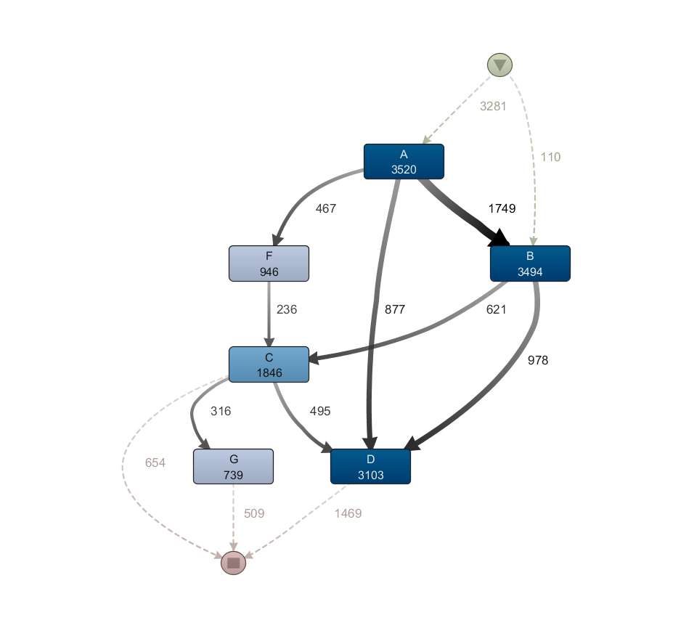
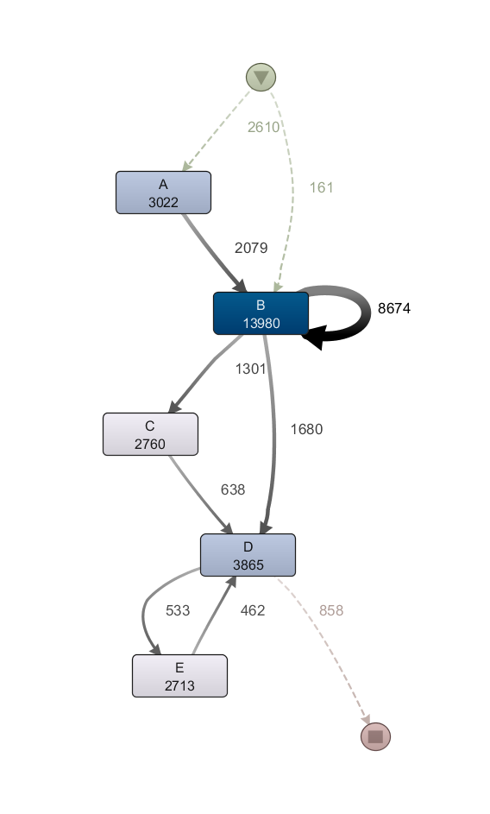
Variants Analysis via Model Differencing
Model Delta
Analysis
Simple claims and quick
Simple claims and slow
S. Suriadi et al.: Understanding Process Behaviours in a Large Insurance Company in Australia: A Case Study. CAiSE 2013

Slide 70
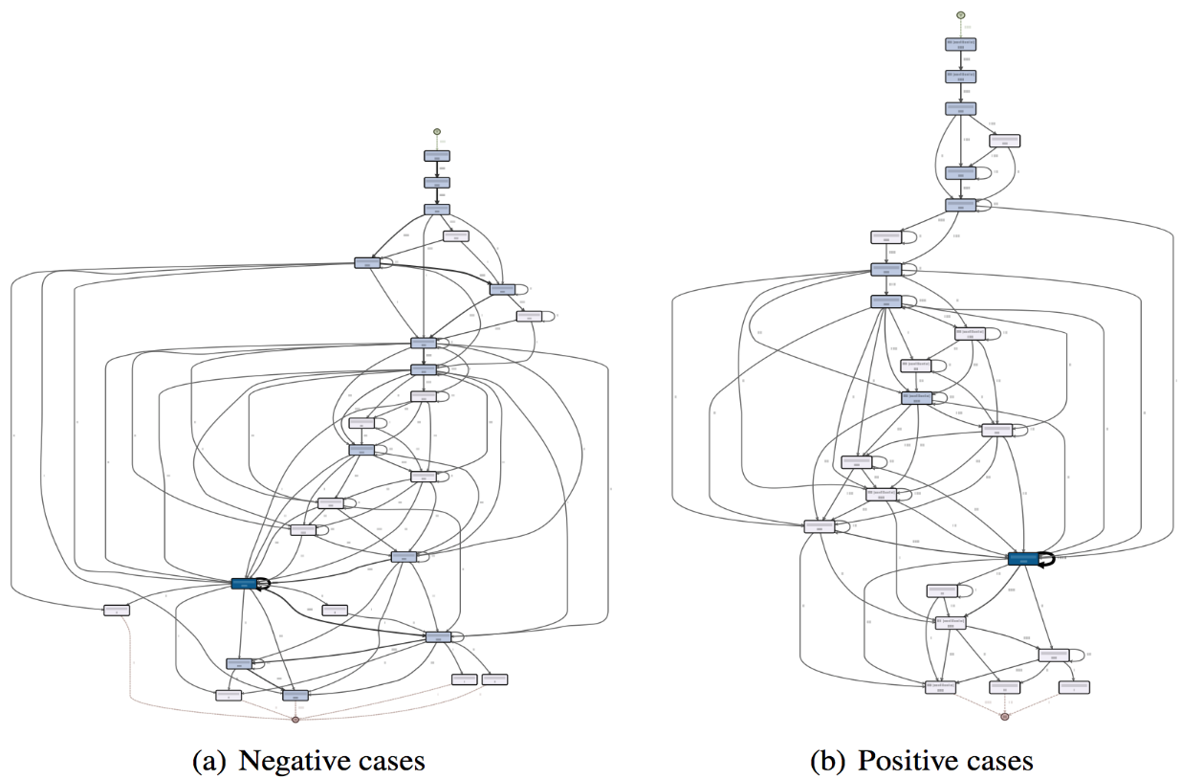

Variants Analysis via Log Delta Analysis
Log Delta Analysis
In L1, “Nursing Primary Assessment” is repeated after “Medical Assign” and “Triage Request”, while in L2 it is not
…
L1 - Short stay
448 cases
7329 events
L2 - Long stay
363 cases 7496 events
N.R. van Beest, L. Garcia-Banuelos, M. Dumas, M. La Rosa, Log Delta Analysis: Interpretable Differencing of Business Process Event Logs. BPM 2015: 386-405
Notes:
Fair enough, our output is intuitively more interpretable, but let’s actually evaluate it.

Slide 71
Chapter 11: Process Monitoring
Contents
Performance Dashboards
Introduction to Process Mining
Automated Process Discovery
Process Performance Mining
Conformance Checking
Variants Analysis
Process Mining in Practice
Recap

Slide 72

Process Mining: Where is it used?
Insurance
Suncorp, Australia
Government
Qld Treasury & Trade, Australia
Health
AMC Hospital, The Netherlands
São Sebastião Hospital, Portugal
Chania Hospital, Greece
EHR Workflow Inc., USA
Transport
ANA Airports, Portugal
Busan Port, South Korea
Kuehne + Nagel, Switzerland-Germany
Electronics
Phillips, The Netherlands
Banking, construction… etc.

Slide 73

Case Study: Suncorp Group
General & life insurance, banking, superannuation and investments management
9M customers
16K employees
$85 billion in assets
Notes:
Suncorp Group includes leading general insurance, banking, life
insurance, superannuation and investment brands in Australia and New
Zealand. The Group has around 16,000 employees and relationships with
nine million customers. It is a Top 20 ASX listed company with over $93 billion in assets.
Suncorp has five core businesses: Personal Insurance; Commercial
Insurance; Vero New Zealand; Suncorp Bank and Suncorp Life. These are
supported by corporate and shared services divisions.

Slide 74






Suncorp Insurance
End to end insurance process
Claims
Product Dev
Service
Sales
500 tasks
Source: Guidewire reference models
Each process is varied by product & brand…
Home | ☑ | ☑ |  |  | ☑ |  | ☑ | ☑ | ☑
Motor | ☑ | ☑ | ☑ |  | ☑ | ☑ | ☑ | ☑ | ☑
Commercial | ☑ |  |  | ☑ | ☑ |  |  | ☑ | ☑
Liability | ☑ | ☑ |  |  | ☑ |  |  | ☑ | ☑
CTP / WC | ☑ | ☑ |  |  | ☑ ☑ |  | ☑ | ☑
30 variations
Total process variants: 3,000+

Slide 75

Processing Problem
Expected Performance Line
Bad
OK
OK
Good
Notes:
A Claims Process mining exercise. A powerful visual tool to display accurate findings from the analysis of claims behaviour.
Here are 6786 claims, from a period of 6 months
claims are considered simple if estimated to be less than x (indicated by the thick vertical line ) and within X number of days otherwise considered complex.
Goal: ‘simple and slow’ cases should be pushed down to become quicker
We needed to understand what makes simple claims slow to complete.
Our Approach: use process mining to discover the characteristics of ‘simple and quick’ cases vs ‘simple and slow’ cases.
Imagine how much time and money this sort of exercise would automate and save, if all processes were mapped consistently.

Slide 76


Deviance & Variance Mining
Discover and analyse actual organisational processes from data
Simple Claim and Quick
Simple Claim and Slow
MODEL
Main result
Key patterns that explain lower performance identified

Slide 77
Process Mining Methodology
1. Frame & Plan the Problem
2. Collect the Data
3. Analyze: Look for Patterns
4. Interpret & Create Insights
5. Create Business Impact
Refined by:
Wil van der Aalst, 2012
Notes:
Pianificazione e giustificazione
Prima di tutto bisogna chiarire la natura del problema e distillare una serie di interrogativi di business per i quali si vuole ottenere una risposta attraverso un’analisi di process mining. Per esempio, nel caso di Suncorp la domanda era ”Perché alcune denunce di danno, seppur di natura semplice, vengono processate in tempi lunghi?”. In base a questi interrogativi, si selezionano i processi coinvolti (per es., nel caso Suncorp, questo era il processo per la gestione di denunce di danno aziendali), e si pianifica la durata del progetto. Questa fase coinvolge uno o più analisti di business, tipicamente coordinati dal loro manager.
1. Estrazione e preparazione dei dati
Gli interrogativi di business vengono poi utilizzati per selezione i sistemi IT coinvolti nei processi sotto analisi, e quindi i log da estrarre da questi sistemi. Si procede quindi con l’estrazione dei dati, che vengono poi preparati per l’analisi attraverso un’opportuna pulizia e filtraggio (per esempio per rimuovere eventi/istanze di processo non rilevanti). In questa fase è necessario l’intervento di un amministratore di sistema che conosce bene i sistemi IT, per l’estrazione dei dati.
2. Analisi di process mining
Una volta che i log sono pronti, si procede all’analisi dei dati in base agli interrogativi, utilizzando una serie di tecniche di process mining. Per esempio nel caso Suncorp è stata utilizzata una combinazione di tecniche di discovery, performance analysis e visualizzazione animata. Questa fase richiede tipicamente l’interazione continua con diverse risorse umane che conoscano bene il settore industriale in esame, come analisti, impiegati dell’azienda che partecipano al processo (per es. gli addetti di sportello nel caso di Suncorp), al fine di ottenere risultati validi e rilevanti.
3-4. Interpretazione dei risultati e process improvement
I risultati vengono poi rifiniti attraverso ulteriori interazioni con vari stakeholder al fine di tracciare delle linee guida per avviare attività di process improvement volte al miglioramento dei processi analizzati. Tali attività sono di natura diversa in base al tipo di problema individuato. Per esempio, nel caso Suncorp si è trattato di implementare una nuova versione del sistema che supporta il processo di gestione denunce di danno, per coordinare la raccolta di una serie di documenti in formato elettronico.
In base ai requisiti degli stakeholder, le deliverable di un progetto di process mining possono essere:
Una collezione di modelli di processo
Un report dettagliato sulle performance di questi processi (tempi di processamento, tempi d’attesa, frequenze relative a singole attività, colli di bottiglia, ecc.)
Statistiche relative al grado di conformità di questi processi a standard industriali o modelli preesistenti in azienda
Un report sull’utilizzo di risorse umane ed IT in questi processi e sulle loro interazioni
Uno o più video che animano le istanze di questi processi sulla base di diverse mappe.

Slide 78
1. Plan & Frame the Problem
Frame a top-level question or phenomenon:
How and why does customer experiences with our order-to-cash processes diverge (geographically, product-wise, temporally)?
Why does the process perform poorly (bottlenecks, slow handovers)?
Why do we have frequent defects or performance deviance?
Refine problem into:
Sub-questions
Identify success criteria and metrics
Identify needed resources, get buy-in, plan remaining phases

Slide 79
1. Plan & Frame the Problem – Suncorp
Often “simple” claims take an unexpectedly long time to complete:
What distinguishes the processing of simple claims completed on-time, and simple claims not completed on time?
What early predictors can be used to determine that a given “simple” claim will not be completed on time?
Define what a “simple” claim is
Create awareness of the extent of the problem
Resources:
2 part-time Business Analysts, 1 DB Administrator, 1 Executive Manager (sponsor)
1 full-time data scientist
Timeframe: 4 months
Notes:
inaspettatamente

Slide 80
2. Collect the data
Find relevant data sources
Information systems, SAP, Oracle, BPM Systems…
Identify process-related entities and their identifiers and map entities to relevant processes in the process architecture
Extract traces
Collect records associated with process entities
Group records by process identifier to produce “traces”
Export traces into standard format (XES or MXML)
Clean
Filter irrelevant events
Combine equivalent events
Filter out traces of infrequent variants if not relevant

Slide 81

3. Analyze – look for patterns
Discover the real process from the logs
Calculate process metrics
Cycle times, waiting times, error rates…
Explore frequent paths
Discover types of cases (good vs bad)
Identify process deviances and early predictors
…

Slide 82

More detailed methodology
Aguirre, Parra, Sepúlveda: Methodological proposal for process mining
Projects. Int. J. Business Process Integration and Management, Vol. 8, No. 2, 2017

Slide 83

Recap

